Slide 1
Word Embedding
Elza cherian

Slide 3
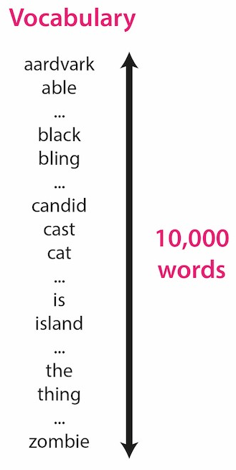
Word Embedding
Numerical values should capture as much of the linguistic meaning of a word as possible.
A well-chosen, informative input representation can have a massive impact on overall model performance.
Why do we need word embeddings
Given this vocabulary of 10,000 words

Slide 4
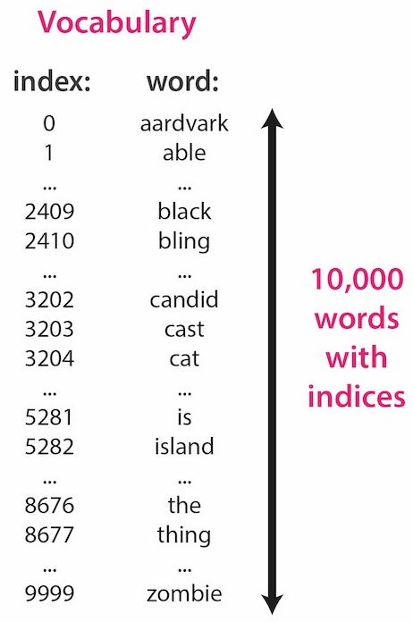
Word Embedding
We could simply assign an integer index to each word:
Given this word-to-integer mapping, we could then represent a word as a vector of numbers as follows:
Each word will be represented as an n-dimensional vector, where n is the vocabulary size
Each word’s vector representation will be mostly “0”, except there will be a single “1” entry in the position corresponding to the word’s index in the vocabulary.

Slide 5
One-hot vector Encoding
Examples:
The vector representation for first vocabulary word “aardvark” will be [1, 0, 0, 0, …, 0], which is a “1” in the first position followed by 9,999 zeroes.
The vector representation for our second vocabulary word “ant” will be [0, 1, 0, 0, …, 0], which is a “0” in the first position, a “1” in the second position, and 9,998 afterwards.
And so on.
This is known as one-hot vector encoding

Slide 6
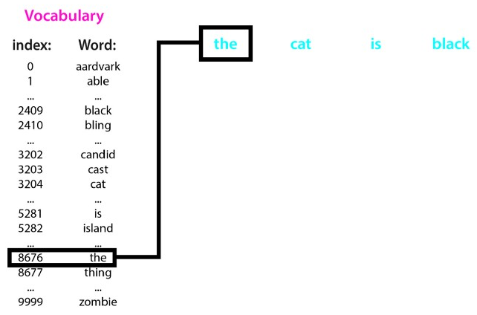
Example
Let’s say NLP project is building a translation model
Translate the English input sentence “the cat is black” into another language.
Represent each word with a one-hot encoding.
Look up the index of the first word, “the”, and find that its index in our 10,000-long vocabulary list is 8676

Slide 7
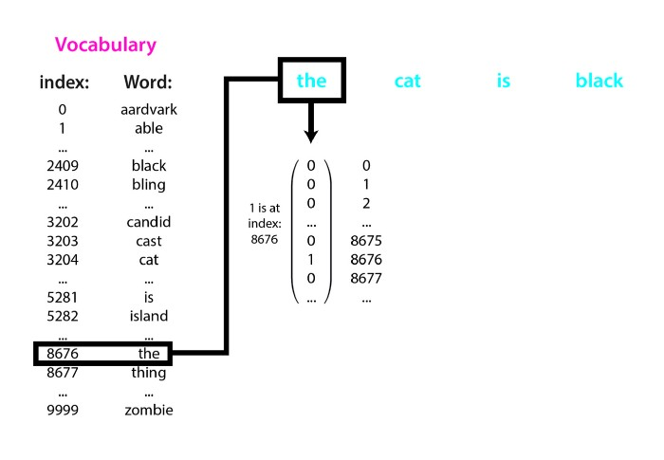
Example
Represent the word “the” using a length 10,000 vector, where every entry is a 0 aside from the entry at position 8676, which is a 1

Slide 8
Example
Do this index look-up for every word in the input sentence, and create a vector to represent each input word.
Process generated a very sparse (mostly zero) feature vector for each input word
Quick and easy way to represent words as vectors of real-valued numbers.

Slide 9
Problems with sparse one-hot encodings
End results can be mediocre, especially when the training dataset is small.
The similarity issue: Similar words like “cat” and “tiger” to have somewhat similar features. But here, “cat” is as similar to “tiger” as literally any other word. Analogy-like vector operations would be tough
The vocabulary size issue. With this approach, as vocabulary increases by n, feature size vectors also increase by length n. One-hot vector dimensionality is the same as number of words. More features means more parameters to estimate, and require exponentially more data to estimate those parameters
The computational issue. Each word’s embedding/feature vector is mostly zeroes, and many machine learning models won’t work well with very high dimensional and sparse features. Danger of running into memory and even storage concerns.

Slide 10
TF-IDF
TF-IDF is a statistical measure used to determine the mathematical significance of words in documents.
Similar to One Hot Encoding.
We generally compute a score for each word to signify its importance in the document and corpus. This method is a widely used technique in Information Retrieval and Text Mining.
TF-IDF = Term Frequency (TF) * Inverse Document Frequency (IDF)
Terminology
t — term (word)
d — document (set of words)
N — count of corpus
corpus — the total document set

Slide 11
Term frequency
Frequency of a word in a document.
Depends on the length of the document and the generality of the word, for example, a very common word such as “was” can appear multiple times in a document.
But if two documents with 100 words and 10,000 words respectively, there is a high probability that the common word “was” is present more in the 10,000 worded document.
But cannot say that the longer document is more important than the shorter document.
For this exact reason, normalization on the frequency value, divide the frequency with the total number of words in the document.
tf(t,d) = count of t in d / number of words in d

Slide 12
Document Frequency
Measures the importance of documents in a whole set of the corpus.
Similar to TF but the only difference is that TF is the frequency counter for a term t in document d, whereas DF is the count of occurrences of term t in the document set N.
DF is the number of documents in which the word is present.
Considers one occurrence if the term is present in the document at least once, do not need to know the number of times the term is present.
df(t) = occurrence of t in N documents
To keep this also in a range, normalize by dividing by the total number of documents.
Main goal is to know the informativeness of a term, and DF is the exact inverse of it

Slide 13
Inverse Document Frequency
IDF is the inverse of the document frequency which measures the informativeness of term t.
When calculate IDF, it will be very low for the most occurring words such as stop words (because they are present in almost all of the documents, and N/df will give a very low value to that word) gives a relative weightage.
idf(t) = N/df
When large corpus size say N=10000, the IDF value explodes. So take the log of IDF.

Slide 14
At query time, when the word is not present in is not in the vocab, it will simply be ignored.
But in few cases, use fixed vocab and few words of the vocab might be absent in the document, in such cases, the df will be 0.
Cannot divide by 0, smoothen value by adding 1 to denominator.
idf(t) = log(N/(df + 1))
Finally, by taking a multiplicative value of TF and IDF, get the TF-IDF score.
tf-idf(t, d) = tf(t, d) * log(N/(df + 1))

Slide 15
Embeddings solve generalisation
Core problem that The generalisation issue: If words like “cat” and “tiger” are indeed similar, some way to pass that information on to the model, since it can piggy-back on the computation path that a similar, more common word takes through the model.
When network sees “liger”, if its embedding is similar to “cat”, then it will take a similar path to “cat” instead of the network having to learn how to handle it completely from scratch.

Slide 16
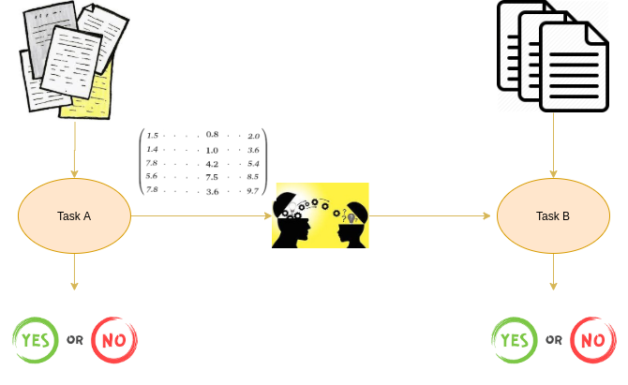
Pretrained Word Embeddings
Embeddings learned in one task that are used for solving another similar task.
Trained on large datasets, saved, and then used for solving other tasks. Form of Transfer Learning
Transfer learning is transferring the learnings of one task to another. Learnings could be either weights or embeddings.

Slide 17
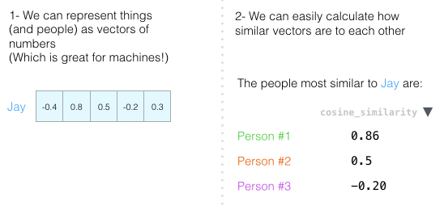
Need of Pretrained Word Embeddings
Pretrained word embeddings capture the semantic and syntactic meaning of a word as they are trained on large datasets. Capable of boosting the performance of NLP models
Learning word embeddings from scratch is a challenging problem due to two primary reasons:
Sparsity of training data: Most real-world problems contain a dataset that has a large volume of rare words. Embeddings learned from these datasets cannot arrive at the right representation of the word. Dataset must contain a rich vocabulary.
Large number of trainable parameters: Number of Trainable Parameters increases while learning embeddings from scratch- Slower training process.

Slide 18
Word2Vec Model
Word2Vec is one of the most popular pretrained word embeddings developed by Google. Word2Vec is trained on the Google News dataset (about 100 billion words). It has several use cases such as Recommendation Engines, Knowledge Discovery, and also applied in the different Text Classification problems
Architecture is a feed-forward neural network with just one hidden layer.
Hence, it is sometimes referred to as a Shallow Neural Network architecture

Slide 19
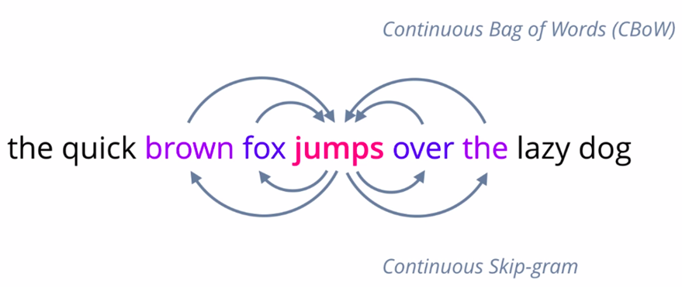
Approaches for Word2Vec
Depending on the way the embeddings are learned, Word2Vec is classified into two approaches:
Continuous Bag-of-Words (CBOW)
Skip-gram model
Model that is able to predict a given word, given neighboring words, or vice versa, predict neighboring words for a given word is likely to capture the contextual meanings of words very well.
Two flavours of Word2Vec models, one where given neighboring words called continuous bag of words, and the other where given the middle word called skip-gram.

Slide 20
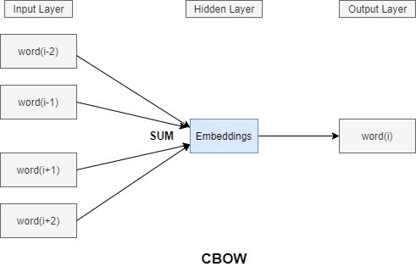
Continuous Bag Of Words
Try to predict the distributed representation of the target word (middle word) from the context words (surrounding words) which lie on either side of the target word within the context window (whose size is configurable but usually is set to 5).
For example, “Pack my box with five dozen liquor jugs”, a context window of size 2 would have the following pairs — (context_window, target_word) — ([five, liquor], dozen), ([dozen, jugs], liquor) and so on.

Slide 21


CBOW
Instead of only looking two words before the target word, look at two words after it.
The dataset virtually built and training the model against would look like this:

Slide 22
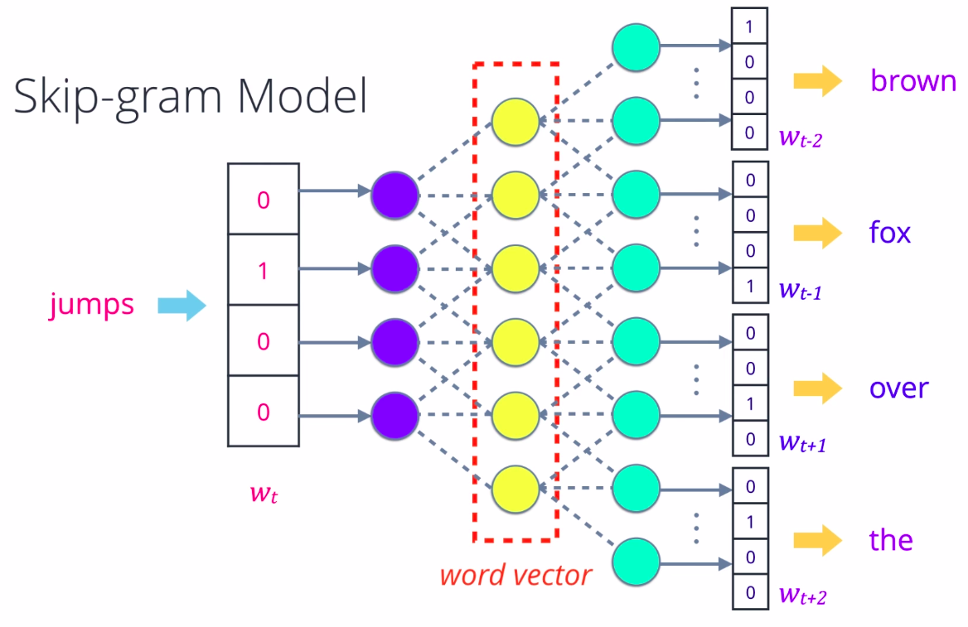
Skip gram model
Pick any word from a sentence, convert it into a one-hot encoded vector and feed it into a Neural network or some other probabilistic model that is designed to predict a few surrounding words, its context.
Using a suitable loss function, the weights or parameters of the model are optimized and this step is repeated till it learns to predict context words as best as it can.
Outputs of hidden layer for a given word become the corresponding word vector.

Slide 23
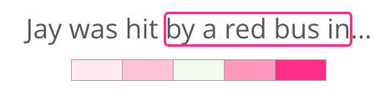
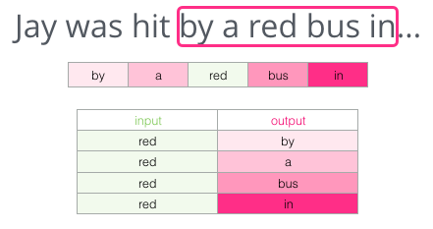
Skip gram
Instead of guessing a word based on its context (the words before and after it), this other architecture tries to guess neighboring words using the current word. Think of the window it slides against the training text as looking like this:
The pink boxes are in different shades because this sliding window actually creates four separate samples in training dataset:

Slide 24
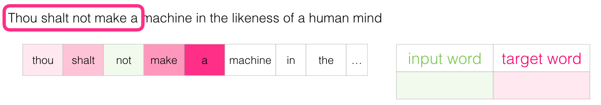
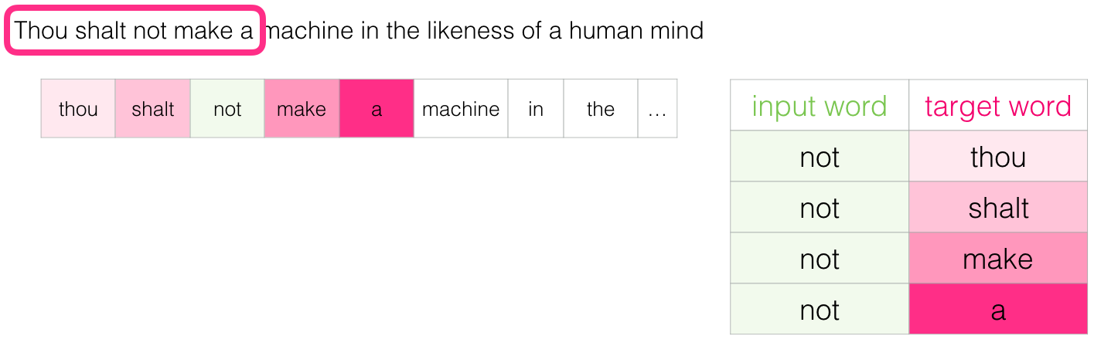
Skip gram
Visualize the sliding window as doing the following:
This would add these four samples to our training dataset:

Slide 25
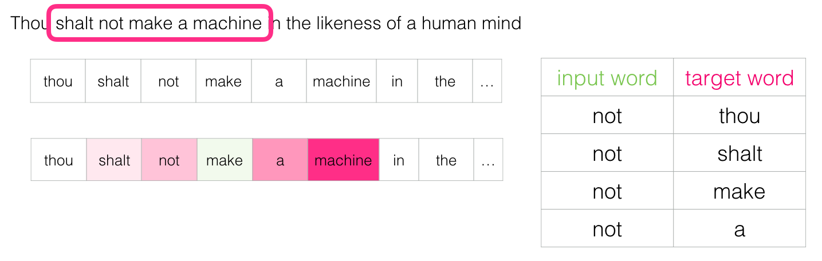
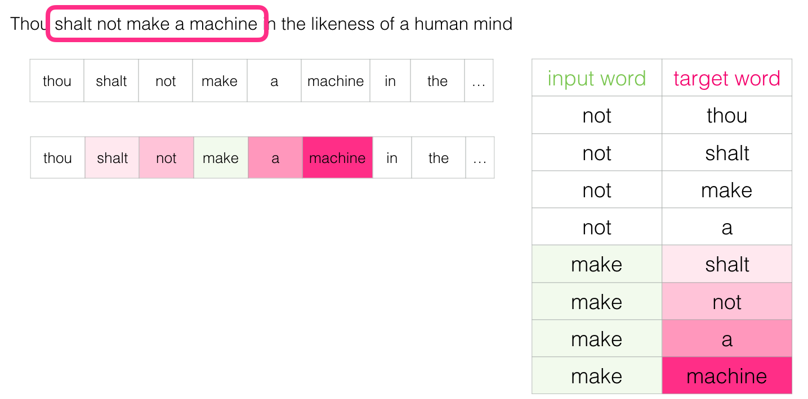
Skip gram
Slide window to the next position:
Generates next four examples:

Slide 26
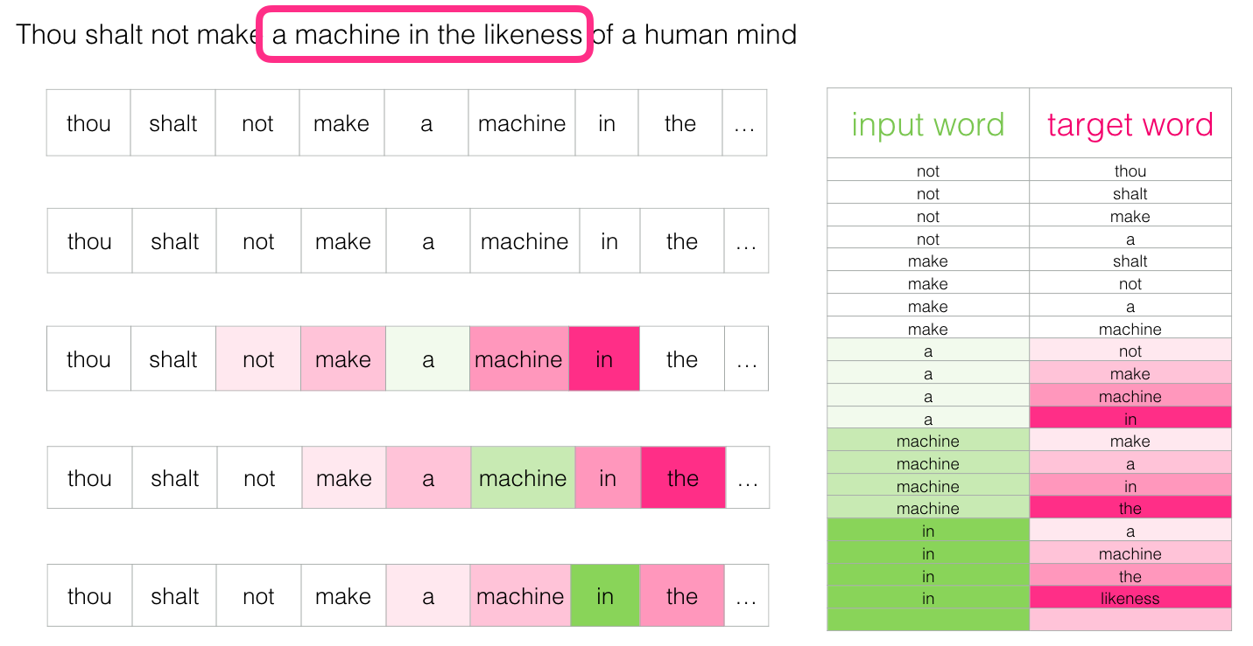
Skip gram
A couple of positions later:

Slide 27
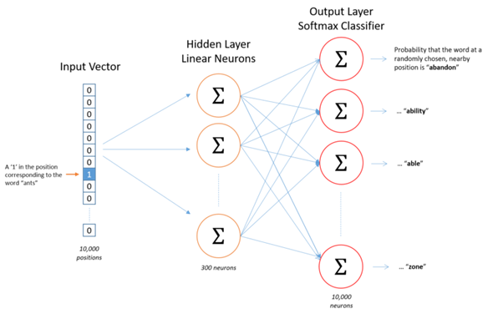
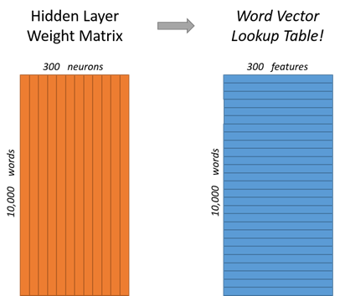
Architecture of Word2Vec
Let’s say learning word vectors with 300 features.
So the hidden layer is going to be represented by a weight matrix with 10,000 rows (one for every word in our vocabulary) and 300 columns (one for every hidden neuron).
300 features is what Google used in their published model trained on the Google news dataset
The number of features is a “hyper parameter” that has to be tuned to the application

Slide 28
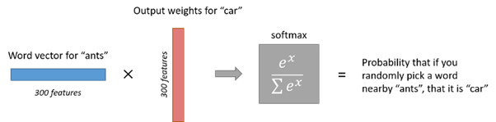
Working
1 x 300 word vector for “ants” then gets fed to the output layer.
The output layer is a softmax regression classifier.
Specifically, each output neuron has a weight vector which it multiplies against the word vector from the hidden layer, then it applies the function exp(x) to the result.
Finally, in order to get the outputs to sum up to 1, we divide this result by the sum of the results from all 10,000 output nodes. Here’s an illustration of calculating the output of the output neuron for the word “car”.

Slide 29
Working
If two different words have very similar “contexts”, then model needs to output very similar results for these two words i.e.. If the word vectors are similar.
If two words have similar contexts, then network is motivated to learn similar word vectors for these two words.
Each dimension of the input passes through each node of the hidden layer. The dimension is multiplied by the weight leading it to the hidden layer.
Because the input is a hot vector, only one of the input nodes will have a non-zero value (namely the value of 1). This means that for a word only the weights associated with the input node with value 1 will be activated

Slide 30
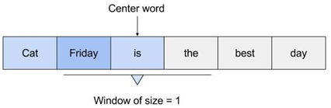
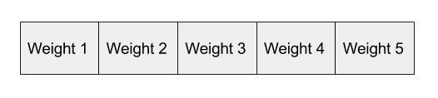
Working
As the input in this case is a hot vector, only one of the input nodes will have a non-zero value.
Only weights connected to that input node will be activated in the hidden nodes. An example of the weights that will be considered is depicted below for the second word in the vocabulary:
The vector representation of the second word in the vocabulary will look as follows, once activated in the hidden layer:
Those weights start off as random values.
The network is then trained in order to adjust the weights to represent the input words.
This is where the output layer becomes important.
Need a way to determine how well it has predicted that a word will fit in a particular context. The context of the word is a set of words within a window around it, as shown below:

Slide 31
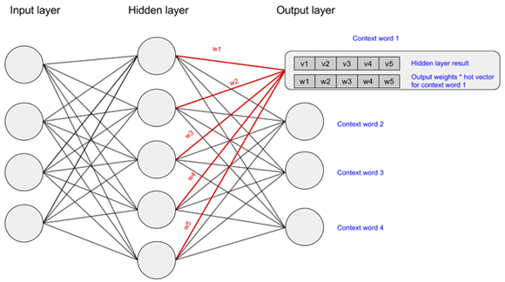
Neural Network
Context for Friday includes words like “cat” and “is”. The aim of the neural network is to predict that “Friday” falls within this context.
Activate the output layer by multiplying the vector that passed through the hidden layer (which was the input hot vector * weights entering hidden node) with a vector representation of the context word (which is the hot vector for the context word * weights entering the output node).
The state of the output layer for the first context word can be visualised below:

Slide 32
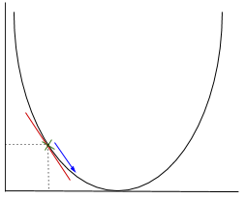
Calculations
The above multiplication is done for each word to context word pair.
Calculate the probability that a word belongs with a set of context words using the values resulting from the hidden and output layers.
Apply stochastic gradient descent to change the values of the weights in order to get a more desirable value for the probability calculated.
In gradient descent need to calculate the gradient of the function being optimised at the point representing the weight that we are changing.
The gradient is then used to choose the direction in which to make a step to move towards the local optimum

Slide 33
Gradient Descent
The weight will be changed by making a step in the direction of the optimal point.
The new value is calculated by subtracting from the current weight value the derived function at the point of the weight scaled by the learning rate.
The next step is using Backpropagation, to adjust the weights between multiple layers.
The error that is computed at the end of the output layer is passed back from the output layer to the hidden layer by applying the Chain Rule.
Gradient descent is used to update the weights between these two layers.
The error is then adjusted at each layer and sent back further.

Slide 34
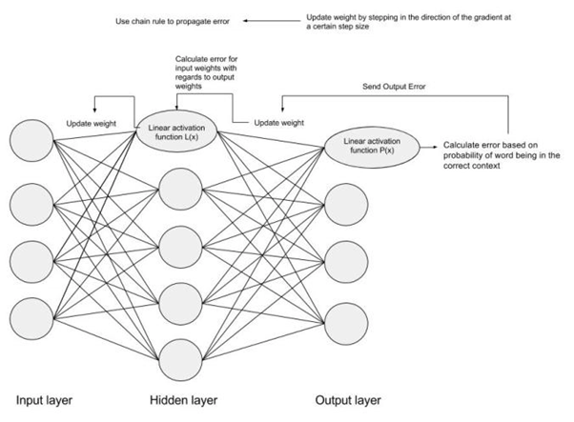
Backpropagation
Here is a diagram to represent backpropagation:

Slide 35
Properties of Word2Vec:
Robust and Distributed representation: Meaning of each word is distributed throughout the vector.
Vector size of Word2Vec is independent of the vocabulary: size of the word vector is up to us, how we want to tune performance versus complexity. It remains constant no matter how many words we train on, unlike the Bag of Words model, for instance, where the size grows with the number of unique words.
Training once and storing in lookup table: pre-train a large set of word vectors, we can use them efficiently without having to transform again and again, just storing them in a lookup table.
Deep learning ready: yields a very robust representation of words

Slide 36
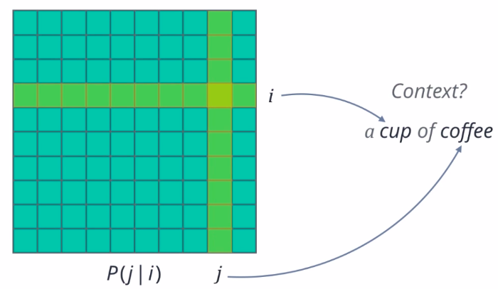
GloVe
Word2Vec is just one type of forward embedding.
Global vectors for word representation tries to directly optimize the vector representation of each word just using co-occurence statistics, unlike Word2Vec which sets up an ancillary prediction task.

Slide 37
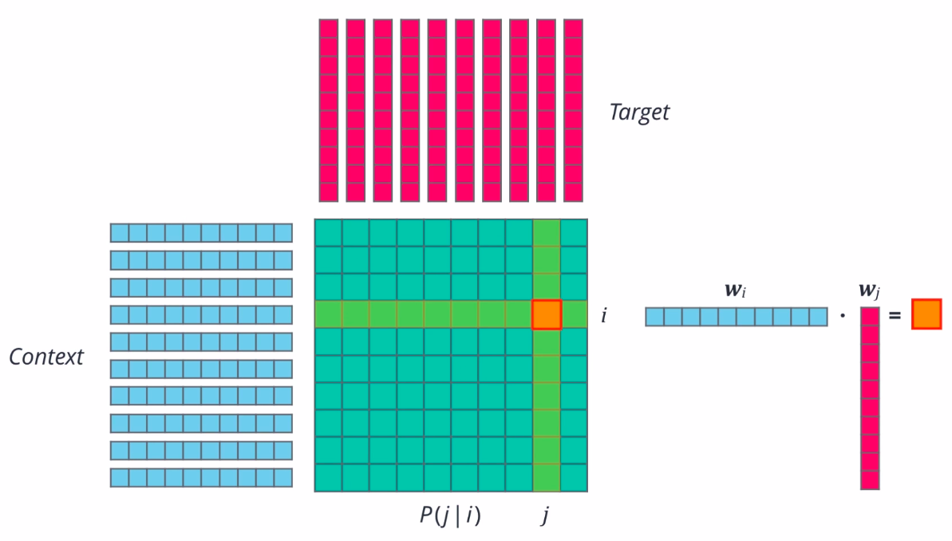
Probability
Probability that the word “j” appears in the context of word “i” is computed, “Pj” given “i” for all word pairs “ij” in a given corpus.
Word “j” is present in the vicinity of word “i”, either right next to it or a few words away.
Count all such occurrences of “i” and “j” in our text collection, and then normalize account to get a probability

Slide 38
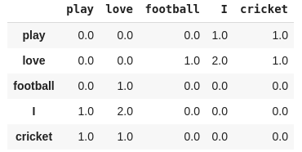
Co-occurrence Matrix
Co-occurrence matrix tells us how often a particular pair of words occur together. Each value is a count of a pair of words occurring together.
For example, consider a corpus: “I play cricket, I love cricket and I love football”. The co-occurrence matrix for the corpus looks like this:

Slide 39
Working of GloVe
A random vector is initialized for each word, actually two vectors.
One for the word when it is acting as a context, and one when it is acting as the target.
For any pair of words “i, j”, dot product of their word vectors, “w_i” times “w_j”, to be equal to their co-occurence probability.
Using this as goal and a suitable loss function, iteratively optimize these word vectors. The result should be a set of vectors that capture the similarities and differences between individual words.
Essentially factorizing the co-occurence probability matrix into two smaller matrices.
This is the basic idea behind GloVe

Slide 40

Calculation of Probability
GloVe uses a Global Log-Bilinear (LBL) Regression Model that uses a simple Weighted Least Squares method.
The GloVe is trained on global word-word co-occurrence counts. The core intuition behind GloVe is that,
Word co-occurrence is the most important statistical information available for the model to ‘learn’. the word representation.

Slide 41
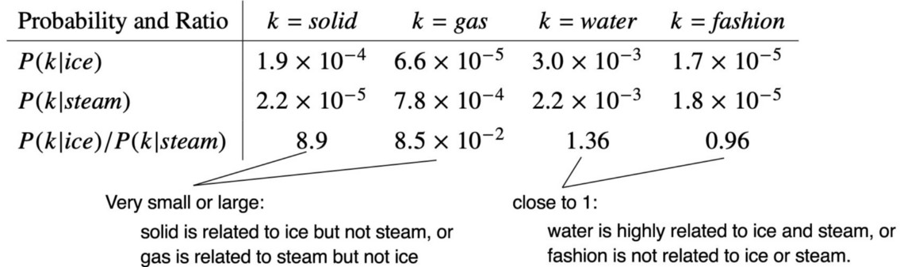
Calculation of Probability
Let us consider an example of how the co-occurrence probability rations work in GloVe.
Pi → Probability of ice
Pj → Probability of steam
Since, ice is more similar to solid than steam, P(solid|ice) higher probability than P(solid|steam).

Slide 42
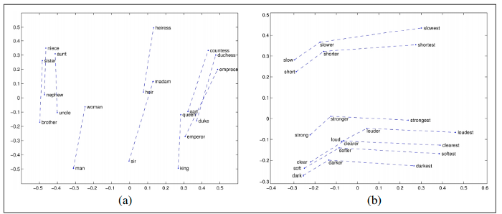
Calculation of Probability
Similarly, both ice and steam are not related to fashion. But, if we consider the standalone probability values for P(fashion|ice) or P(fashion|steam), it will not help to infer the lack of relationship.
Hence, the idea behind GloVe is to consider co-occurrence probabilities as a ‘ratio’ and use it as a word representation. See that P(fashion|ice) / P(fashion|steam) almost equals 1 (0.96)

Slide 43
Sentence Embedding
Working directly with individual sentences.
In case of large text using only words would be very tedious and be limited by the information extracted from the word embeddings.
Suppose, a sentence like ‘I don’t like crowded places’, and a few sentences later, ‘However, I like one of the world’s busiest cities, New York’.
Sentence embedding techniques represent entire sentences and their semantic information as vectors. This helps the machine in understanding the context, intention, and other nuances in the entire text.
It is also a very popular research area with interesting techniques that break the barrier in helping the machine understand language.
Doc2Vec
SentenceBERT
InferSent
Universal Sentence Encoder

Slide 44
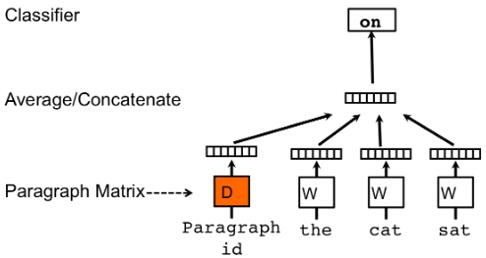
Doc2Vec
An extension of Word2Vec, unsupervised algorithm and introduces another ‘paragraph vector’.
Two ways to add the paragraph vector to the model.
1.1) PVDM(Distributed Memory version of Paragraph Vector):
We assign a paragraph vector sentence while sharing word vectors among all sentences.
Average or concatenate the (paragraph vector and words vector) to get the final sentence representation.
Predict the next sentence given a set of sentences

Slide 45
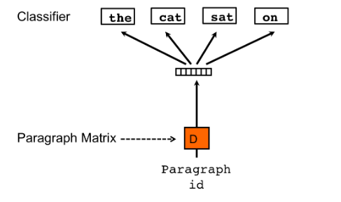
1.2) PVDOBW( Distributed Bag of Words version of Paragraph Vector):
PVDOBW is another extension, this time of the Skip-gram type.
Here, we just sample random words from the sentence and make the model predict which sentence it came from(a classification task)

Slide 47
https://medium.com/geekculture/introduction-to-word-embeddings-nlp-17f35dda86cf
https://jalammar.github.io/illustrated-word2vec/
https://towardsdatascience.com/tf-idf-for-document-ranking-from-scratch-in-python-on-real-world-dataset-796d339a4089#:~:text=TF%2DIDF%20stands%20for%20%E2%80%9CTerm,Information%20Retrieval%20and%20Text%20Mining.

